Slide 1
Data Analytics
Week-4
In this module, you will assume the role of a data engineer at an e-commerce company. Your company has finished setting up a data warehouse. Now you are assigned the responsibility to design a reporting dashboard that reflects the key metrics of the business.
Learning Objectives
Create a project in IBM Cloud Pak for Data / Watson Studio.
Add a Cognos Dashboard Embedded (CDE) service to a project in IBM Cloud Pak for Data.
Navigate around the CDE user interface
Upload external data files to a project in IBM Cloud Pak for Data.
Create a Cognos data source that connects to tables in a data warehouse.
Create a business intelligence dashboard using Cognos Analytics or CDE.
Add several data visualizations and charts to the dashboard.

Slide 2
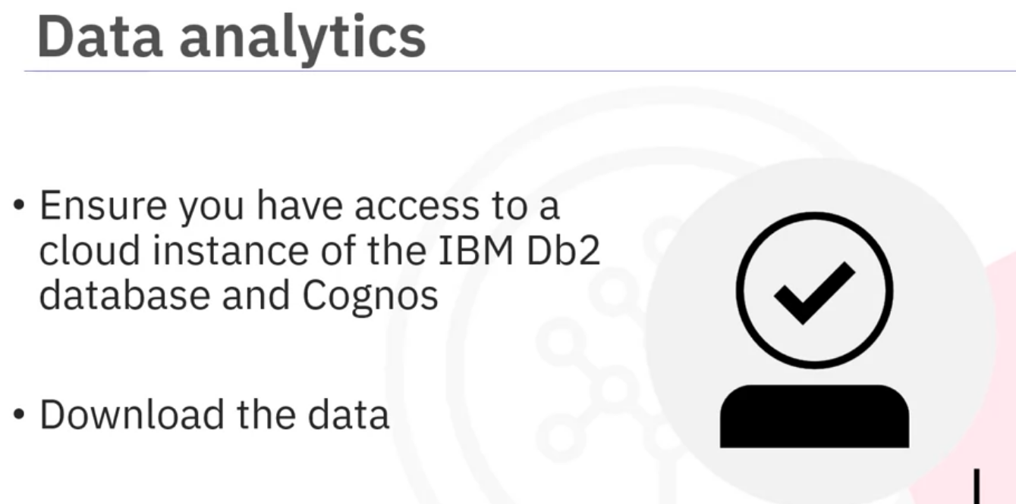
ensuring that you have access to a cloud instance of the IBM Db2 database and IBM Cognos Analytics.
After you have access to the cloud instance of both, you will download the data from the link provided.

Slide 3
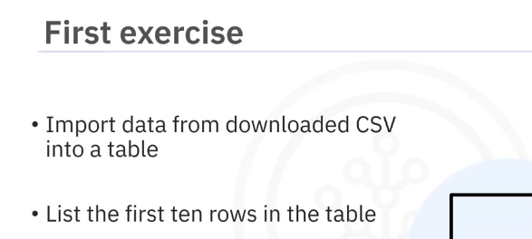
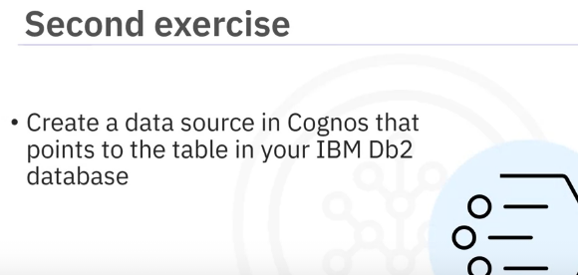
In the second exercise, you will
create a data source in Cognos that points to the table in your IBM Db2 database.

Slide 4
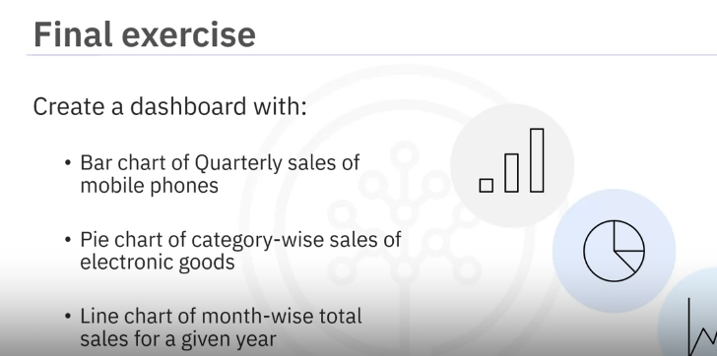
In the final exercise, you will create a dashboard by performing tasks such as creating a bar chart of Quarterly sales of mobile phones, a pie chart of category-wise sales of electronic goods, and a line chart of month-wise total sales for a given year.

